Slide 1
Data Mining Topic: Class Imbalance Problem
Dr. J Angel Arul Jothi
Department of Computer Science

Slide 2
Text Book Chapter 5
Section 5.7

Slide 3
Class Imbalance Problem
Lots of classification problems where the class distribution is skewed (more records from one class than another)
Credit card fraud
Intrusion detection
Defective products in manufacturing assembly line
COVID-19 test results on a random sample
A correct classification of the rare class in these applications often has greater value than a correct classification of the majority class
Key Challenge:
Accuracy is not well-suited for imbalanced class

Slide 4
Problem with Accuracy
Accuracy treats every class as equally important
It is not suitable for datasets having class imbalance
Example: Consider a credit card transaction dataset.
If 1% of the transactions are fraudulent, then a model that predicts every transaction as legitimate has an accuracy of 99% even though it fails to detect any of the fraudulent transactions.

Slide 5
Problem with Accuracy
Consider a credit card fraud detection dataset containing 1000 transactions
Number of legitimate transactions = 990
Number of fraudulent transactions = 10
If a model predicts every transaction to be legitimate, accuracy is 990/1000 = 99%
This is misleading because this trivial model does not detect any fraud transactions
Detecting the rare class is usually more interesting (e.g., frauds, intrusions, defects, etc)
 | PREDICTED CLASS
ACTUAL CLASS |  | fraud | legitimate
 | fraud | 0 | 10
 | legitimate | 0 | 990

Slide 6
Alternative Metrics
For binary classification, the rare class is often denoted as the positive class, while the majority class is denoted as the negative class
Confusion matrix for a binary classification problem
 | PREDICTED CLASS
ACTUAL CLASS |  | + | -
 | + | TP | FN
 | - | FP | TN

Slide 7
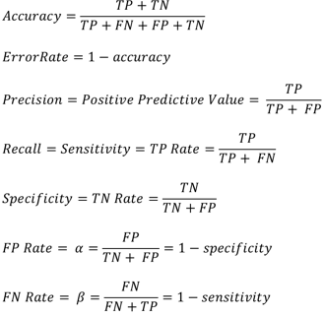
Alternative Metrics
 | PREDICTED CLASS
ACTUAL CLASS |  | + | -
 | + | TP | FN
 | - | FP | TN

Slide 8
Alternative Metrics
Recall and precision are employed in applications where successful detection of one of the classes is considered more significant than detection of the other classes
Precision determines the fraction of records that actually turns out to be positive in the group the classifier has declared as a positive class
The higher the precision is, the lower the number of false positive errors

Slide 9
Alternative Metrics
Recall measures the fraction of positive examples correctly predicted by the classifier
A large recall means very few positive examples are misclassified as the negative class
It is often possible to construct models that maximize one metric but not the other
Example: A model that declares every record to be the positive class will have a perfect recall, but very poor precision
Building a model that maximizes both precision and recall is the key challenge

Slide 10
Alternative Metrics
Precision and recall can be summarized into another metric known as the F1 measure
F1 represents a harmonic mean between recall and precision
The harmonic mean of two numbers x and y tends to be closer to the smaller of the two numbers
Hence, a high value of F1-measure ensures that both precision and recall are reasonably high

Slide 11
Which model is better?
 | PREDICTED
ACTUAL |  | Class=Yes | Class=No
 | Class=Yes | 0 | 10
 | Class=No | 0 | 990
A
Accuracy: 99%
 | PREDICTED
ACTUAL |  | Class=Yes | Class=No
 | Class=Yes | 10 | 0
 | Class=No | 500 | 490
Accuracy: 50%
B
 | PREDICTED
ACTUAL |  | Class=Yes | Class=No
 | Class=Yes | 5 | 5
 | Class=No | 0 | 990
C
Accuracy: 99.5%

Slide 12
Alternative Measures
 | PREDICTED CLASS
ACTUAL CLASS |  | fraud | legitimate
 | fraud | 0 | 10
 | legitimate | 0 | 990
Precision = 0/0 = 0
Recall (TPR) = 0/10 = 0
F score = 0
Accuracy = 990/1000 = 0.99 = 99%

Slide 13
Alternative Measures
 | PREDICTED CLASS
ACTUAL CLASS |  | fraud | legitimate
 | fraud | 10 | 0
 | legitimate | 500 | 490
Precision = 10/510 = 0.019 = 1.9%
Recall (TPR) = 10/10 = 1 = 100%
F score = 0.057 = 5.7%
Accuracy = 500/1000 = 50%

Slide 14
Alternative Measures
 | PREDICTED CLASS
ACTUAL CLASS |  | fraud | legitimate
 | fraud | 5 | 5
 | legitimate | 0 | 990
Precision = 5/5 = 1 = 100%
Recall (TPR) = 5/10 = 0.5 = 50%
F score = 0.67 = 67%
Accuracy = 995/1000 = 0.995 = 99.5%

Slide 15
Receiver operating characteristic (ROC) curves
Visual tool for comparing two classification models
Shows the trade-off between the true positive rate (TPR) and the false positive rate (FPR) at various classification thresholds
TPR is the proportion of positive tuples that are correctly labeled by the model
FPR is the proportion of negative tuples that are mislabeled as positive
Given that
TP the number of true positive
FP the number of false positive
P the number of positive tuples
N the number of negative tuples
TPR = TP/P which is sensitivity
FPR = FP/N which is 1-specificity

Slide 16
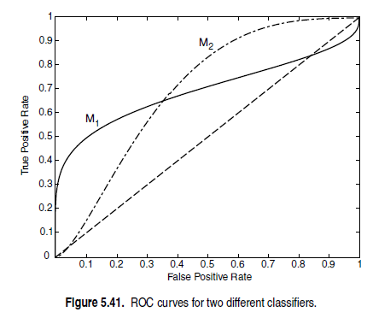
ROC curves for two different classifiers.
The ideal model TPR=1, FPR=0
A good classification model should be located as close as possible to the upper left corner of the diagram

Slide 17
ROC curves for two different classifiers.
A model that makes random guesses reside along the main diagonal

Slide 18
ROC curves for two different classifiers.
M1 is better than M2 when FPR is less than 0.36, while M2 is superior when FPR is greater than 0.36. Clearly,
neither of these two classifiers dominates the other

Slide 19
Area under the ROC curve
The area under the ROC curve (AUC) provides another approach for evaluating which model is better
It is the measure of the ability of a classifier to distinguish between different classes
If the model is perfect, then its area under the ROC curve would equal 1
If the model simply performs random guessing, then its area under the ROC curve would equal 0.5

Slide 20
Generating an ROC curve
To plot an ROC curve for a given classification model, M, the model must be able to return a probability for each test tuple
Probability that each test tuple belong to the positive class
Sort the tuples so that the tuple that is most likely to belong to the positive class appears at the top of the list, and the tuple that is least likely to belong to the positive class lands at the bottom of the list
Apply a threshold t at each value of the probabilities
Such that tuples whose probabilities are greater than or equal to t are considered positive and all other tuples are considered negative
Count the number of TP, FP, TN, FN at each threshold
TPR = TP/(TP+FN)
FPR = FP/(FP + TN)

Slide 21
Generating an ROC curve
Consider the test set with 5 +ve
samples and 5 –ve samples.
The posterior probabilities P(+|x)
score output by a na¨ıve
Bayes classifier for the test set
is also shown
Plot the ROC curve of the give
data
Instance | Score | True Class
1 | 0.95 | +
2 | 0.93 | +
3 | 0.87 | -
4 | 0.85 | +
5 | 0.85 | -
6 | 0.85 | -
7 | 0.76 | -
8 | 0.53 | +
9 | 0.43 | -
10 | 0.25 | +

Slide 22
Generating an ROC curve
Answer

Slide 23
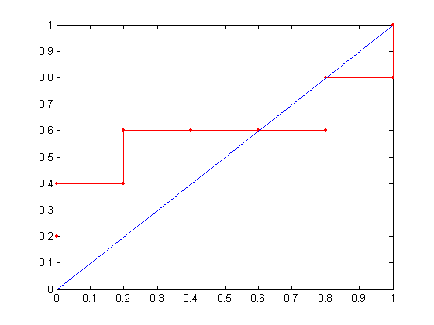
Generating an ROC curve
Answer: ROC

Slide 24
Cost-sensitive classification
A cost-sensitive classification technique takes the cost matrix into consideration during model building and generates a model that has the lowest cost
Cost matrix – encodes penalty for classification
Let C(i, j) denote the cost of predicting a record from class i as class j
C(+,−) is the cost of committing a false negative error
C(−, +) is the cost of generating a false alarm (positive)
A negative entry in the cost matrix represents the reward for making correct classification
Misclassifying rare class is more expensive than misclassifying majority class

Slide 25

Cost-sensitive classification
Given a collection of N test records, the overall cost of a model M for two class classification is
Under the 0/1 cost matrix
C(+, +) = C(−,−) = 0
C(+,−) = C(−, +) = 1

Slide 26
Computing Cost of Classification
Cost Matrix | PREDICTED CLASS
ACTUAL CLASS | C(i,j) | + | -
 | + | -1 | 100
 | - | 1 | 0
Model M₁ | PREDICTED CLASS
ACTUAL CLASS |  | + | -
 | + | 150 | 40
 | - | 60 | 250
Model M₂ | PREDICTED CLASS
ACTUAL CLASS |  | + | -
 | + | 250 | 45
 | - | 5 | 200
Accuracy = 80%
Cost = 3910
Accuracy = 90%
Cost = 4255

Slide 27
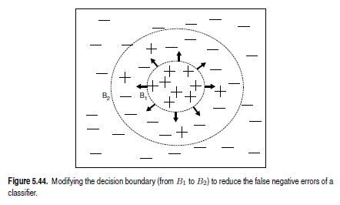
Cost-sensitive classification
If false negative errors are the most costly, the learning algorithm will try to reduce these errors by extending its decision boundary toward the negative class
In this way, the generated model can cover more positive examples, although at the expense of generating additional false alarms

Slide 28
Sampling-based Approaches
Modify the distribution of training data so that rare class is well-represented in training set
100 positive examples and 1000 negative examples
Undersample the majority class
a random sample of 100 negative examples is chosen to form the training set along with all the positive examples
Oversample the rare class
replicates the positive examples until the training set has an equal number of positive and negative examples
Hybrid
combination of undersampling the majority class and oversampling the rare class

Slide 29
Thank you
https://www.youtube.com/watch?v=FAr2GmWNbT0

